Slide 1
Emotion Based Music Player using a combination of OpenCV and Raspberry Pi
Presented By - Aditya Anand

Slide 2
Introduction
In today’s era, technology is evolving to offer deeply personalized experiences.
Our project addresses the need for systems that not only entertain but also connect with the user’s emotional state. By integrating facial expression analysis into a music recommendation system, we bridge the gap between human emotions and machine intelligence.
This system dynamically responds to the user’s mood, thereby enhancing both the listening experience and overall engagement.

Slide 3
OBJECTIVE
Real-Time Emotion Detection: Low-latency processing on Raspberry Pi
Privacy & Control: No third-party APIs, local data handling
User Engagement: Seamless transition between moods
Scalability: Potential use in entertainment, mental health, and IoT setups

Slide 4
Literature survey/Existing
Previous research has laid the groundwork for emotion-based systems using datasets like FER-2013, CK+, AffectNet, and JAFFE.
Traditional approaches often employed static rule-based methods and machine learning models such as SVMs. Recent advancements have seen a shift toward dynamic, CNN-based models which provide superior accuracy in emotion detection.
However, many existing solutions rely on external APIs for music streaming, leading to concerns about data privacy and customization. Our project builds on these studies by creating a standalone system that marries efficient emotion detection with tailored music recommendation, building a hardware implementation which provides room for future advancements.

Slide 5
Methodology
1. Data Collection & Preprocessing
The ‘fer+ck+augmentedfer’ dataset was used.
Images were cleaned, resized, and preprocessed for better model performance.
Data augmentation techniques were applied to improve model generalization.
2. Model Selection & Training
A Convolutional Neural Network (CNN) was designed for emotion classification.
Various optimizers and activation functions were tested to achieve better accuracy.

Slide 6
Methodology
3. Emotion Detection & Music Recommendation
A camera module on Raspberry Pi 4 captures real-time images.
The trained model predicts the user's emotion from the captured image.
Based on the detected emotion, a predefined playlist suggests appropriate songs.
4. Web App Development & Deployment
A web application was developed for user interaction.
The app allows users to get real-time emotion-based music recommendations.
The web app was deployed on Raspberry Pi 4 for a seamless experience.

Slide 7
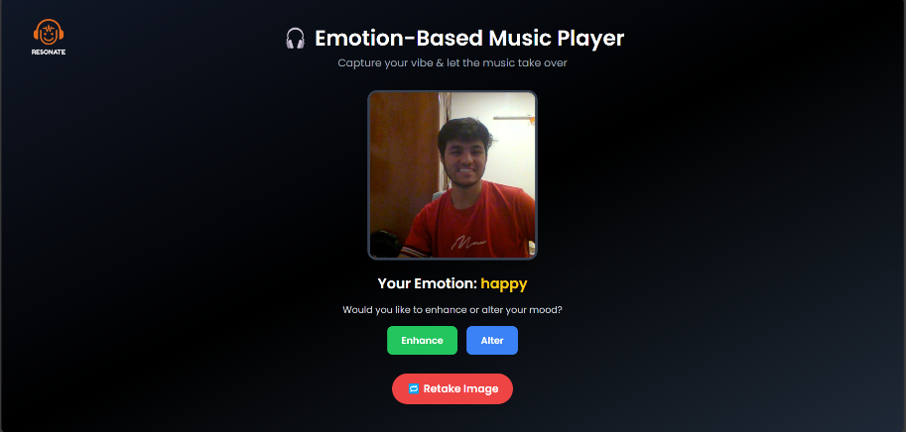

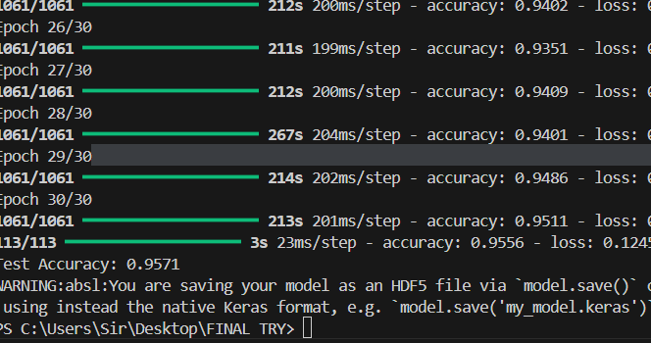
Methodology
5. Testing & Accuracy Improvement
The initial model had low accuracy (<50%), prompting further model improvements.
The final optimized model achieved an accuracy of ~95%.
The system was rigorously tested on the Raspberry Pi.

Slide 8
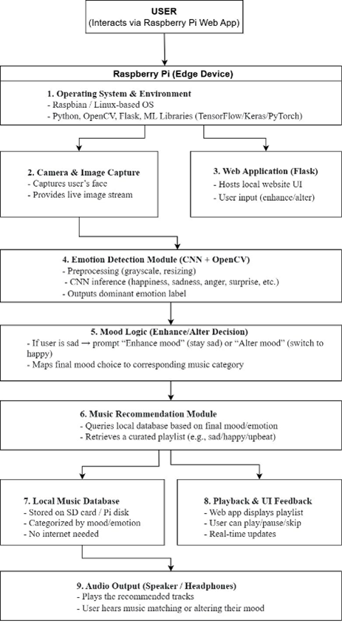

Slide 9
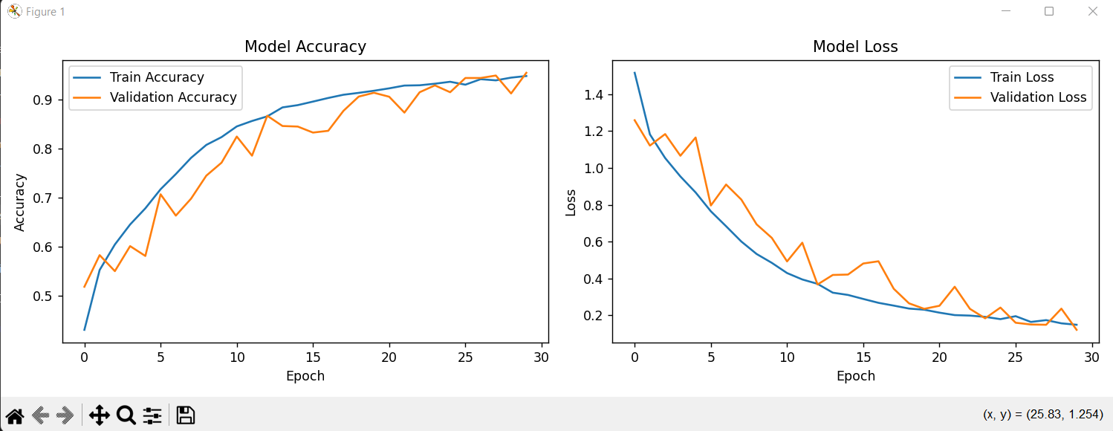
FINDINGS/RESULTS
Accuracy: Achieved ~95% on Testing data
Real-Time Feasibility: Fast on Raspberry Pi
User Feedback: Smooth and responsive music transitions
Robustness: Better generalization due to combined dataset

Slide 10
CONCLUSION
In summary, the Emotion Based Music Player Device redefines how technology can interact with human emotions by delivering a tailored music experience through real-time emotion recognition. Our project has shown that a self-contained, privacy-preserving system is not only feasible but also effective in enhancing user engagement. Looking ahead, future enhancements may include:
Incorporating personalized music playlists, other functionalities or experiences for the User (Shorts, Games, Meditation / Personalized workouts etc.).
Expanding the input modalities to include voice, text, and physiological signals for even more accurate emotion detection.
Integrating the system into IoT-enabled smart environments for adaptive control, further enriching the user experience.

Slide 11
References
[1] J. Smith and L. Zhang, “Emotion recognition using multi-modal data,” uses facial, speech, and physiological signals for accurate emotion detection.
[2] A. Johnson and P. Kumar, “Speech-driven emotion-music mapping,” maps speech features to music tracks using deep learning.
[3] M. Lee and H. Chen, “EEG signals in music recommendation,” utilizes EEG signals for precise emotion-based music recommendations.
[4] R. Brown and T. Patel, “Transformer-based emotion detection,” applies transformer models for real-time emotion recognition.
[5] K. Garcia and S. Nakamura, “Cultural preferences in music emotion mapping,” analyzes cross-cultural differences in music-emotion associations.

Slide 12
[6] D. Wilson and E. Martinez, “Real-time adaptive music systems,” introduces reinforcement learning for adaptive music systems.
[7] B. Taylor and F. Singh, “Valence-arousal mapping in music,” uses the valence-arousal model for mapping emotions to music.
[8] H. Lopez and N. Wang, “Privacy-preserving emotion detection,” implements federated learning for privacy in emotion detection.
[9] O. Ahmed and G. Silva, “Deep learning in music recommendation,” employs CNNs and RNNs for feature extraction and music prediction.
[10] L. Nguyen and J. Rivera, “Adaptive music therapy system,” designs a therapeutic system for stress management using music.

Slide 13
[11] X. Chang and X. Zhang, “Music emotion prediction using recurrent neural networks,” applies RNNs to predict user emotions and recommend music.
[12] S. Dutta and S. Mookherjee, “Exploring the emotional landscape of music,” analyzes Spotify music data to study valence trends and genre variations.
[13] T. Babu and R. R. Nair, “Emotion-aware music recommendation system,” recommends music based on real-time emotional context.
[14] W. Cui and P. Sarmento, “MoodLoopGP: Emotion-conditioned music generation,” generates music loops conditioned by multi-granular emotion features.
[15] “Emotion-based music player using facial expression recognition,” uses facial expressions to detect user emotions and play music

Slide 14
[16] “Affective music player: Emotion-based playlist generation,” creates playlists based on user emotional states.
[17] “Emotion-based smart music player using deep learning,” combines deep learning models for emotion detection and music mapping.
[18] M. Ahmad and J. Rivera, “Music recommendation through sentiment analysis,” uses sentiment analysis to recommend mood-matching songs.
[19] S. Kumar and L. Zhang, “Reinforcement learning for music recommendation,” leverages RL algorithms for personalized music suggestions.
[20] H. Lopez and N. Wang, “Federated learning in music emotion systems,” applies federated learning for secure emotion-based music recommendation.

Slide 15
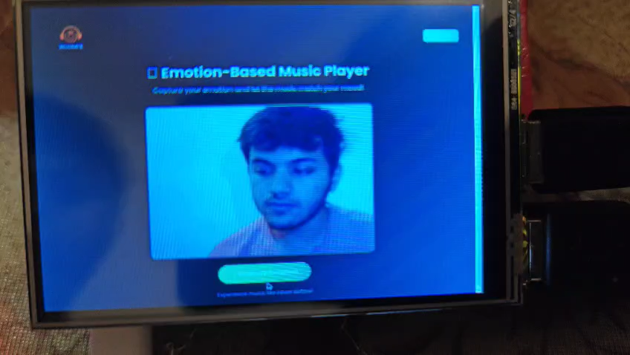
Testing Video

Slide 16
THANK YOU

